Slide 1
Development of a data encryption application for improved security on wireless networks BY AKPIKIE, Oghenemairo (SSE/011/10038) SUPERVISED BY DR. A.O AKINWUMI JUNE, 2015

Slide 2
INTRODUCTION
Wireless networking presents many productivity advantages because of increased accessibility to information resources
However, wireless technology also creates new threats and alters the existing information security risk profile
For example, because communications takes place "through the air" using radio frequencies, the risk of interception is greater than with wired networks
The popularity of wireless Networks is a testament primarily to their convenience, cost efficiency, and ease of integration with other networks and network components

Slide 3

STATEMENT OF PROBLEM
One of the problems associated with wireless networks is in the area of data security
Most data/information shared on a wireless network are poorly protected or encrypted and this poses a huge problem in the privacy of information in an organization
Hence, encryption of data shared in a network will provide data security and also limit the actions of intruders in a network

Slide 4

AIM AND OBJECTIVES
The aim of this project was to provide data encryption security on a wireless network.
The Objectives for embarking on this project are:
to design a system;
implement the system; and
test the system.

Slide 5
LITERATURE REVIEW
AUTHORS | RELATED WORKS | YEAR
J.Manikandan and S.Vijayaragavan | Ad-hoc Wireless Network | 2010
Abdel-Karim R and Al Tamimi | Asymmetric and Symmetric Encryption techniques | 2006
K.Lauter | Elliptic Curve Diffie-Hellman cryptography | 2004

Slide 6
METHODOLOGY
Elliptic Curve Diffie-Hellman encryption was used to design the system using Visual studio 2012
C# programming language was used to implement the system
The application was tested on several computer systems to ascertain the functionality of the system, two operating systems platforms were used to test the system; namely: Windows 7 and Windows 8.1

Slide 7
ARCHITECURAL FLOW

Slide 8
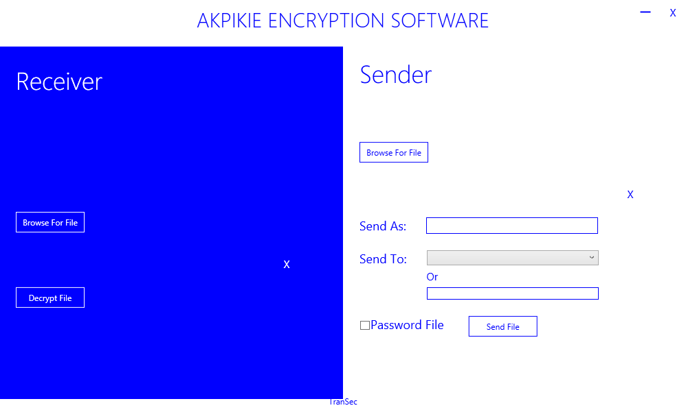
RESULT and DISCUSSION

Slide 9
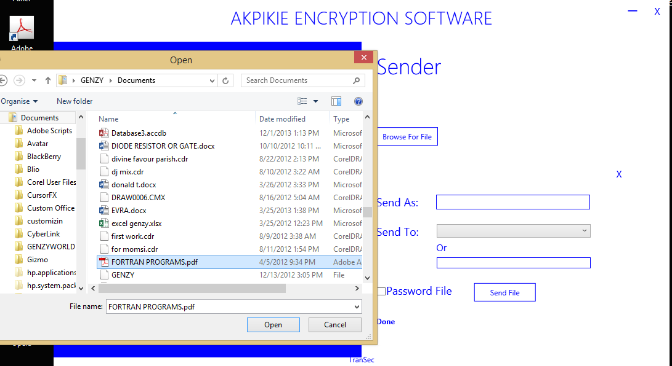
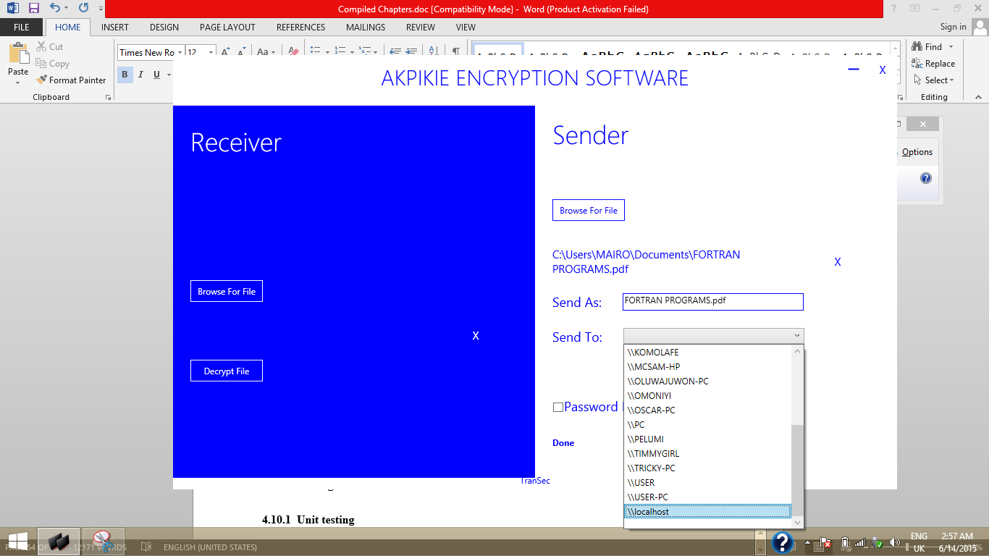

Slide 10
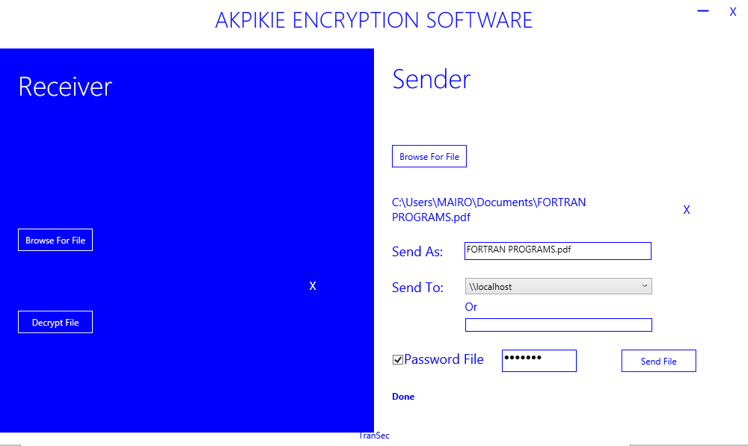
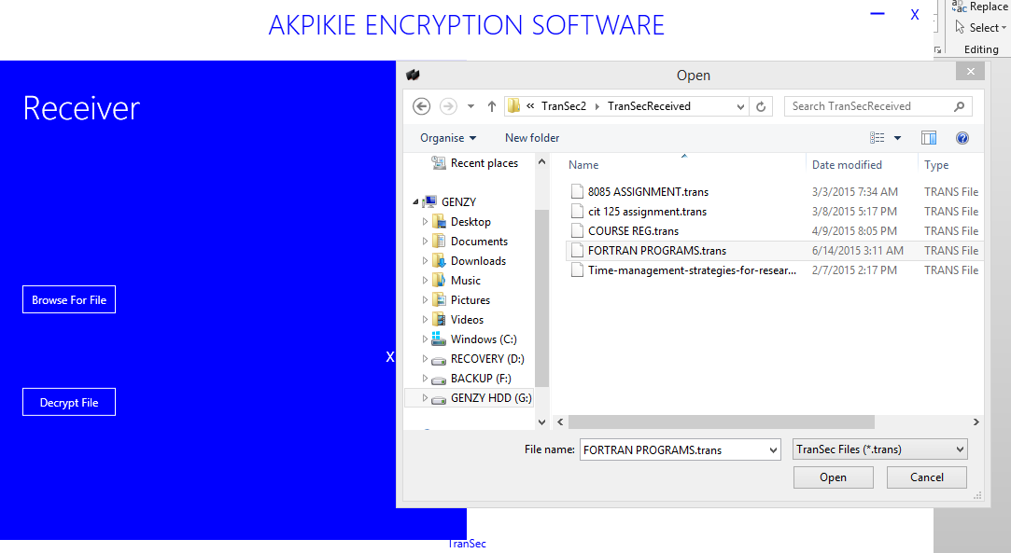

Slide 11
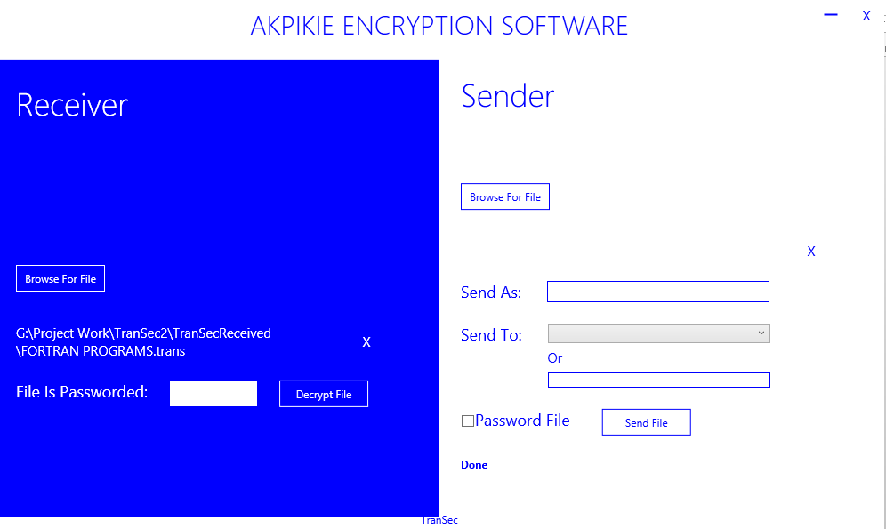
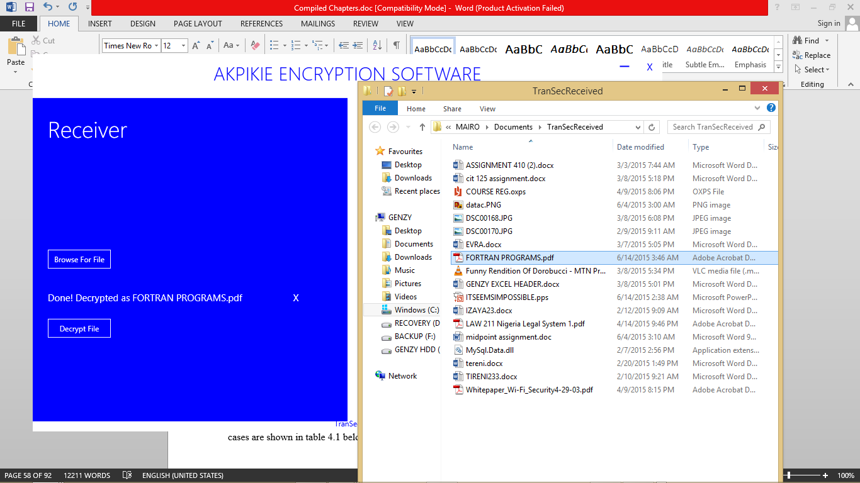

Slide 12
S/NO | Sender’s end | Test case | Expected result | Result
1 | “Browse For File” button | Click the “Browse For File” button | Open document folder to allow for file selection | Pass
2 | “Send To” Drop-down box | Click the drop-down box | Box displays a list of systems or devices connected to that network | Pass
3 | “Send To” Text box | Manually enter the system’s network ID | The application accepts the valid destination system’s ID as an alternative to the “Send To” Drop-down box | Pass
4 | “Password File” Checkbox | Select the checkbox | With the selection of the checkbox, it automatically shows a textbox which enables the user to enter a set of characters to secure the file that had been selected. | Pass
5 | “Send File” button | Click the “Send File” | It sends the encrypted file/document to the recipient of the document | Pass
S/NO | Receiver’s end | Test case | Expected result | Result
1 | “Browse For File” button | Click the button | The button opens the file in which the received encrypted documents are kept | Pass
2 | “Decrypt File” button | Click the button | With the click of the button, the received encrypted document will be decrypted using the Elliptic Curve Diffie-Hellman decryption algorithm and automatically displays the decrypted document | Pass

Slide 13
CONCLUSION
As a result of this project, an application that can encrypt and decrypt files/documents etc. has been designed using the Elliptic Curve Diffie Hell-man encryption. This encryption type offers many advantages such as speed, performance, improved security, biodiversity etc.
This will provide efficient security in the sending and receiving of data/information in an organization.

Slide 14
CONTRIBUTION TO KNOWLEDGE
This study will aid massive security improvement in the protection of data/information being sent in an organization, company, Government institution, military, etc.
Along with, evolving user/organizational/institutional etc. demands will fuel the ongoing development of data encryption system already involved, and encourage creative ideas about delivering services with a whole new scope and perspective.

Slide 15
REFERENCE
Abdel-Karim, R., Tamimi, AI. (2006). Security in Wireless Data Networks: A Survey Paper
Boncella, R. J. (2002). Wireless Security (9th ed.). Atlanta, NY:
Corporation, S. (2002). Wireless LAN Security.USA:Author.
Dorothy, E. Denning and Peter, J. Denning Data Security accessed June 2015
Dr.Singh, G. (2012).Security Issues in Wireless Local Area Network (WLAN)
Enge, A. (1999). Elliptic Curve and their Application to Cryptography; an Introduction
Lauter, K. (2004). The Advantages of Elliptic Curve Cryptography for Wireless Security. UK: Microsoft Corporation
Manikandan, J., Vijayaragavan, S. (2010). Multihost ad-hoc Network with the clustered Security Networks
Neils, P. and Peter, H. (2003) “Hide and Seek: An Introduction to Steganography” IEEE Trans. Security and Privacy, MAY/JUNE 2003, 1540-7993
Panduranga H.T., Naveen Kumar S.K (2010) / (IJCSE) International Journal on Computer Science and Engineering Vol. 02, No. 02, 2010, 297-300
Retrieved 13/04/15 http://en.wikipedia.org/wiki/Elliptic_curve_Diffie-Hellman/
Wi-Fi Alliance. (2003). Wi-Fi Protected Access: Strong, Standard-based, Interoperable Security for today’s Wi-Fi Networks

Slide 16


